Slide 1
DECORATION TRENDS:
3D LOGOS & MORE
Presenter: Alison Zuccaro

Slide 2
Agenda
Hats, hat, hats – they are everywhere with even more style, personalization and decoration options than ever before. In this class, we will take you through a quick how-to on hat decoration to keep your business ahead of the trends. You will learn the right decoration method for different fabrics, how to print an entire hat, and get dimensional with 3D logos.

Slide 3
Copyright Notice
Please note, I have and created the materials for this presentation and they are copyrighted. Distribution or reproduction of content is prohibited.
PPAI has permission to utilize this PowerPoint presentation for educational purposes.
Images have been purchased or I have taken them myself.

Slide 4
Poll Question
Do you own a heat press?

Slide 5
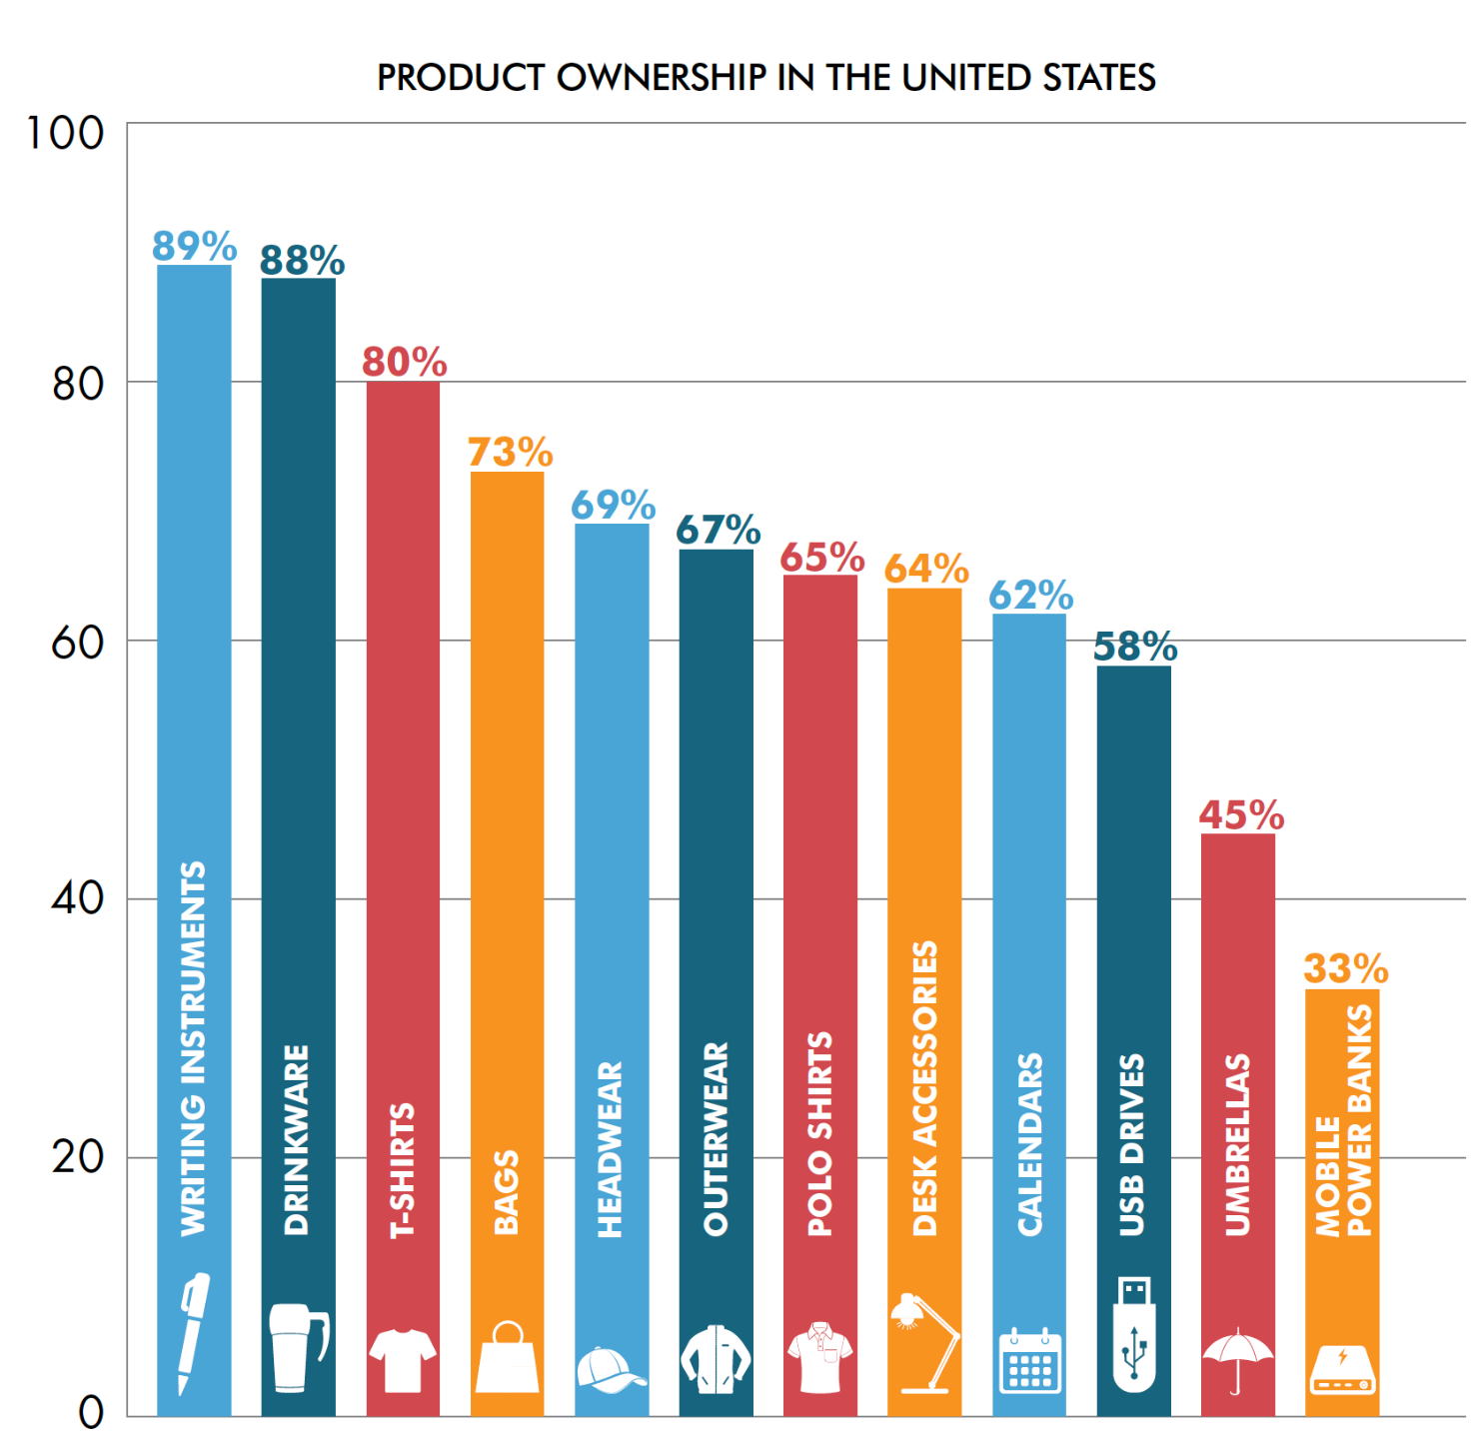
STATE OF HEADWEAR

Slide 6
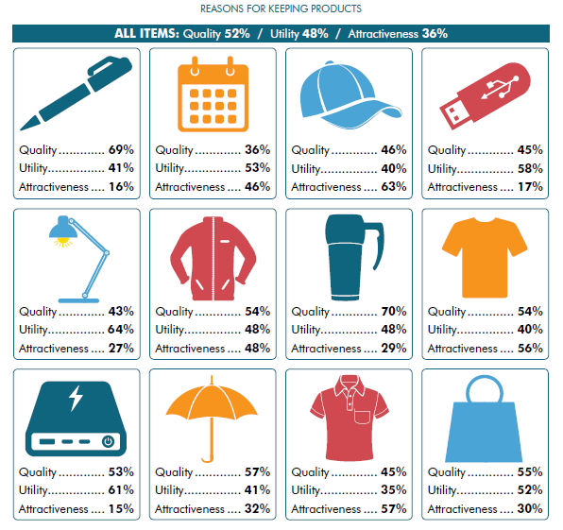
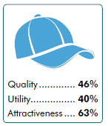
REASONS FOR KEEPING PRODUCTS

Slide 7
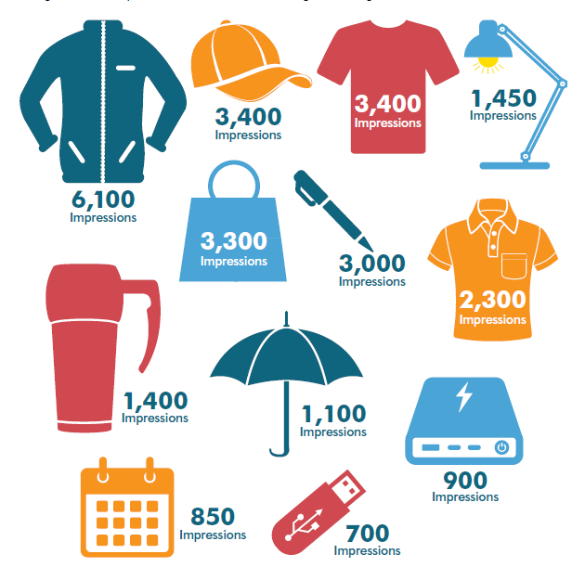
COMPARING IMPRESSIONS

Slide 8
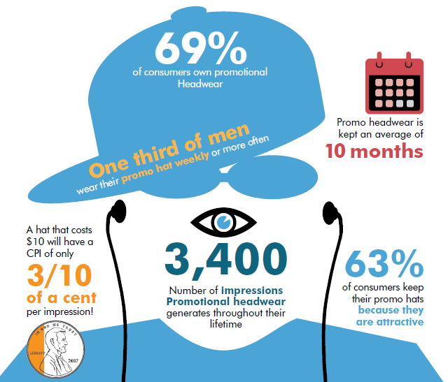
HEADWEAR SUMMARY

Slide 9
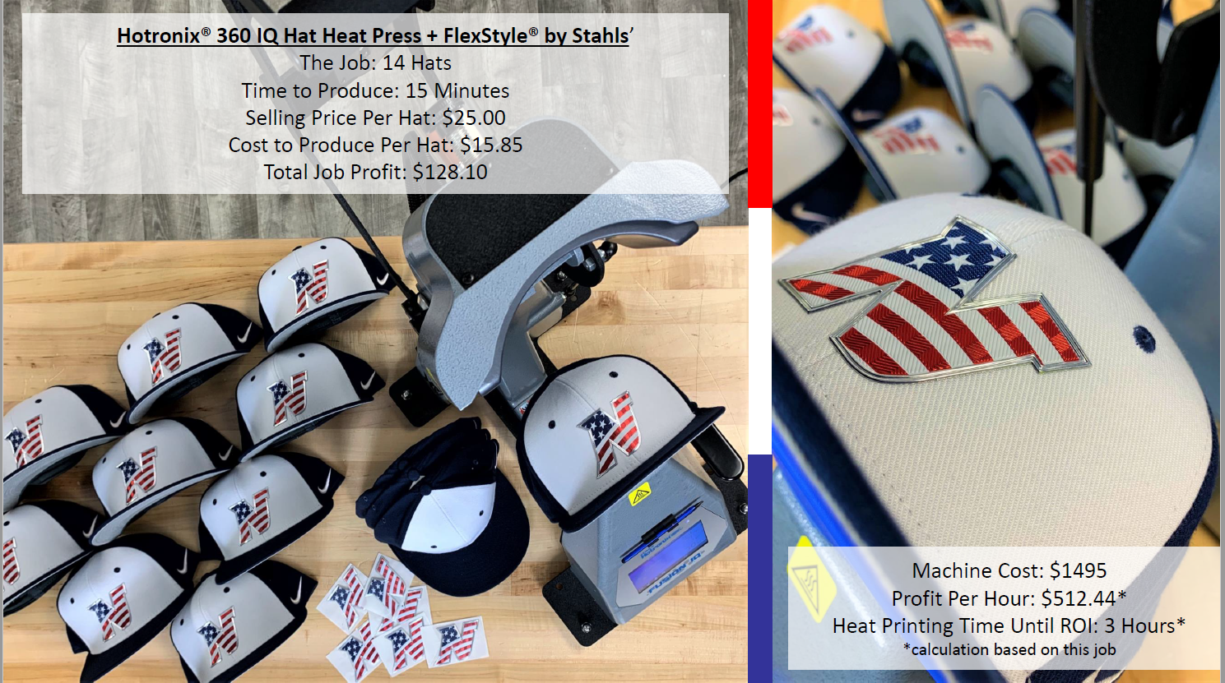

Slide 10
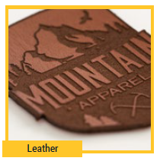
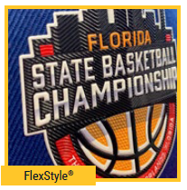
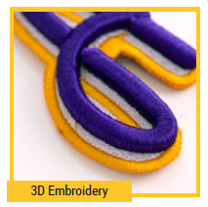
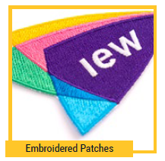
4 PRODUCTS THAT DRIVE DECORATION

Slide 11
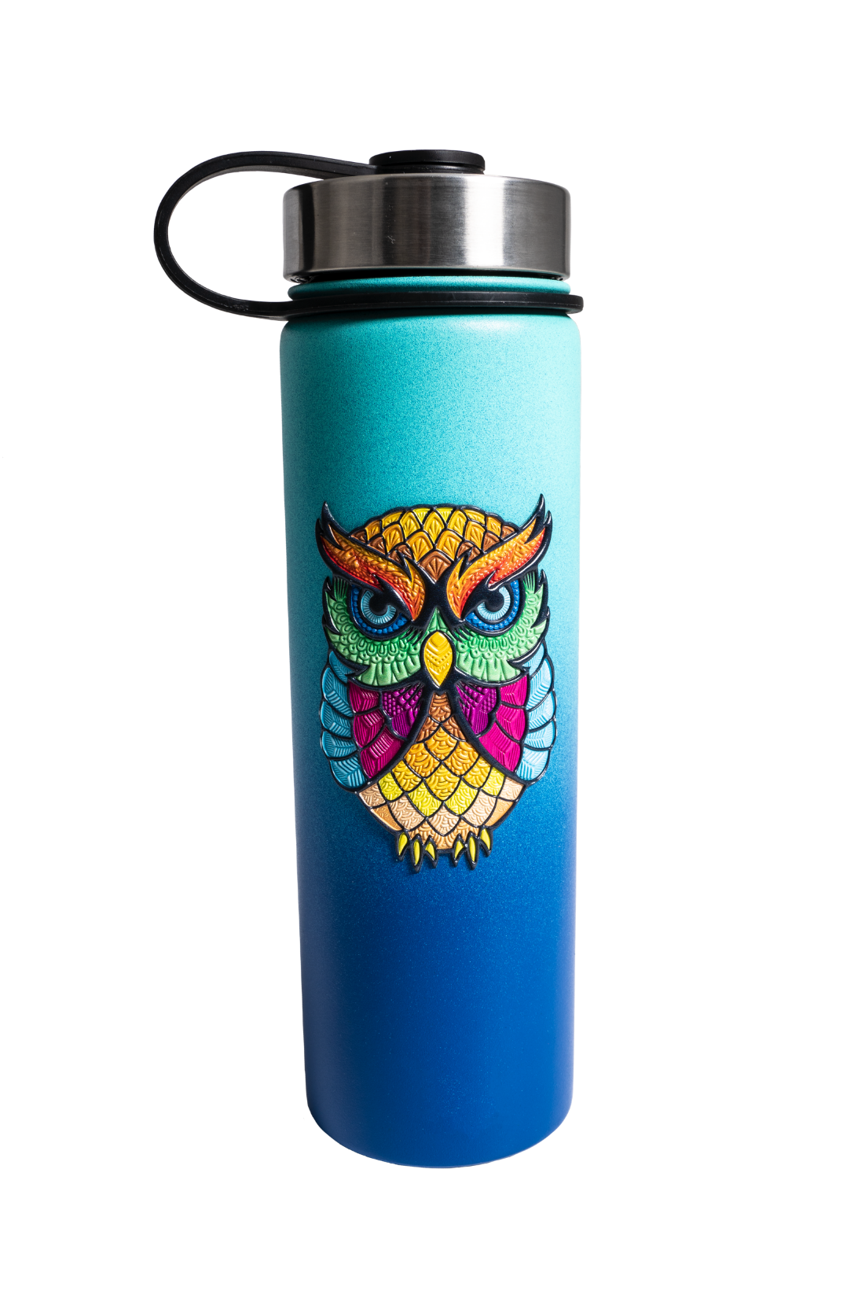
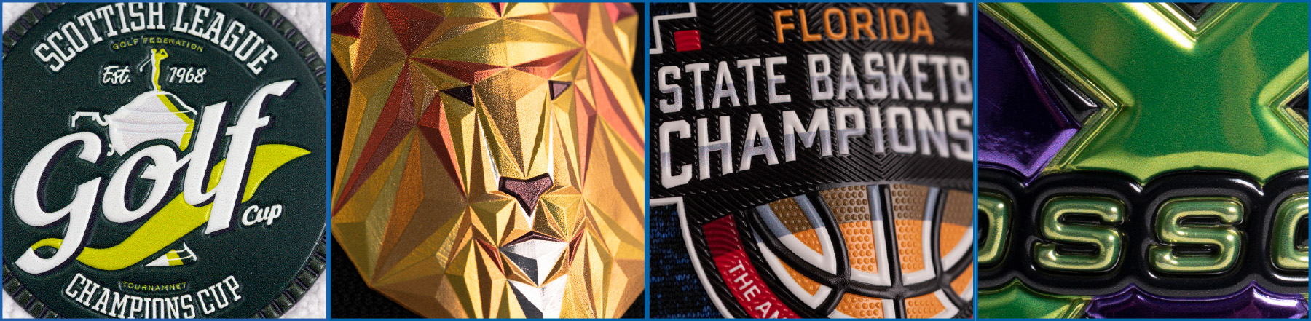
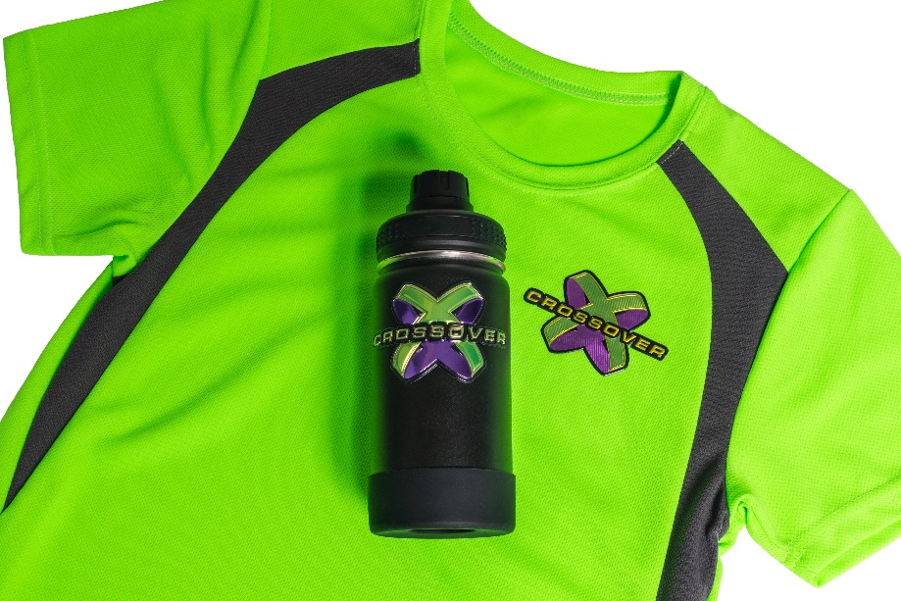
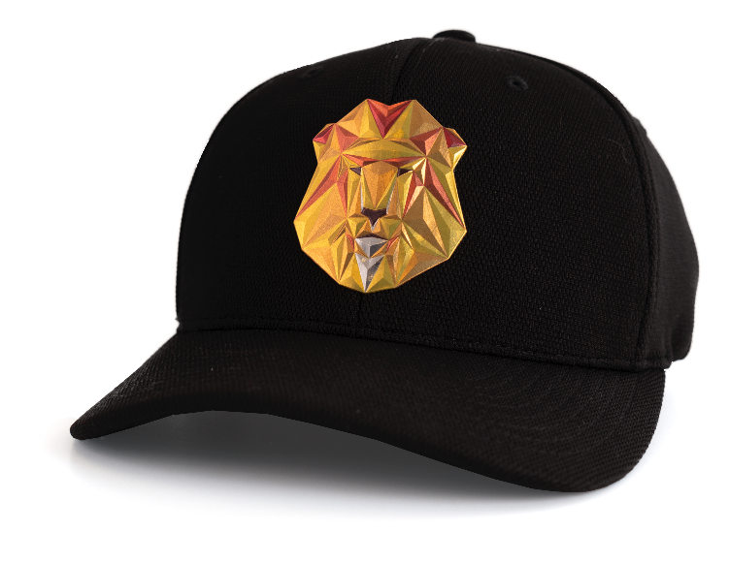
FlexStyle® Emblems
Premium embossed emblems with unique, cutting-edge look. Perfect for everything from promotional and recognition hard goods to corporate wear and sports jerseys.

Slide 12
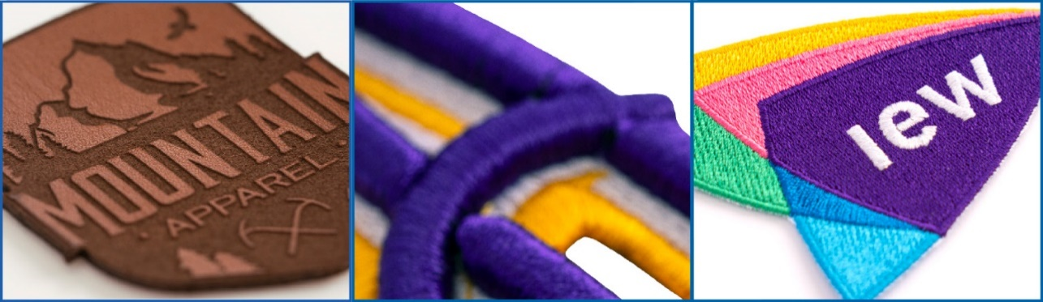
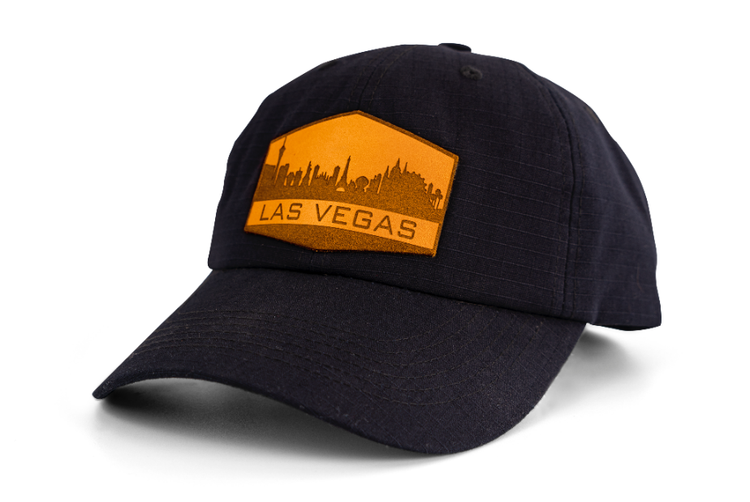
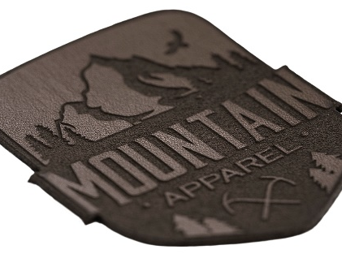
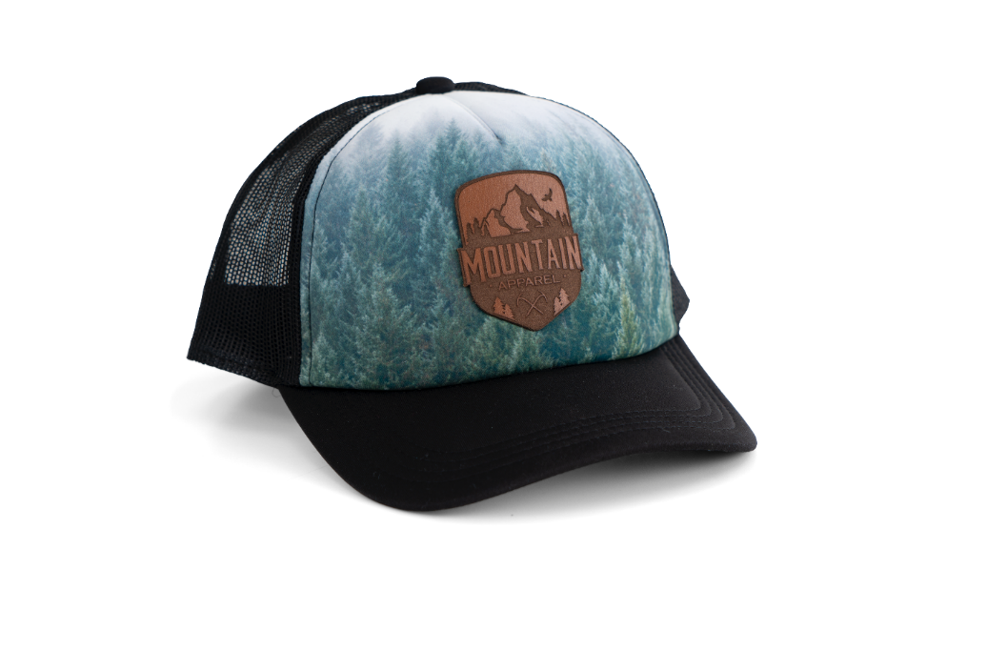
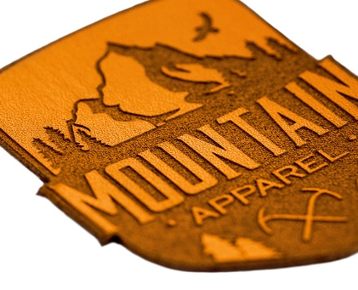
Patches
Leather – Caramel
3D-Embroidery
Embroidery
Leather – Taupe
Leather – Natural

Slide 13
Tools
PRODUCT VIDEO
FLIP BOOK

Slide 14
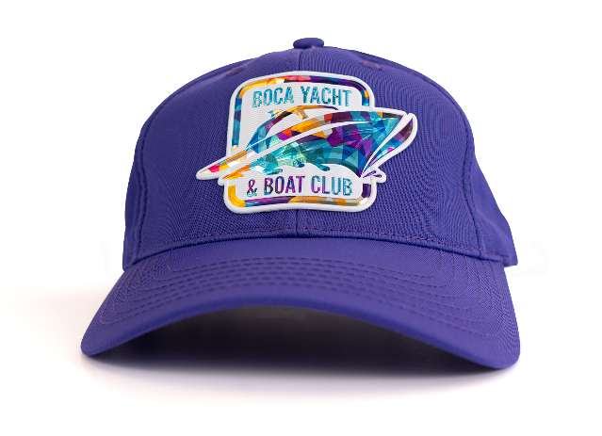
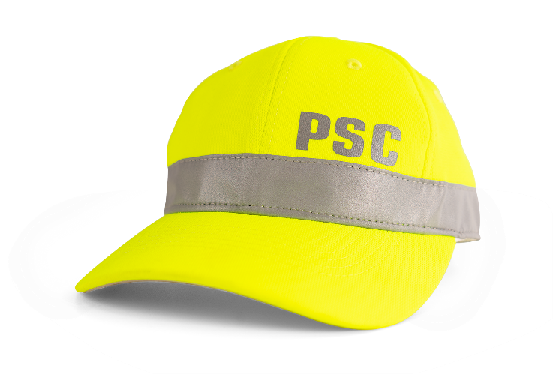
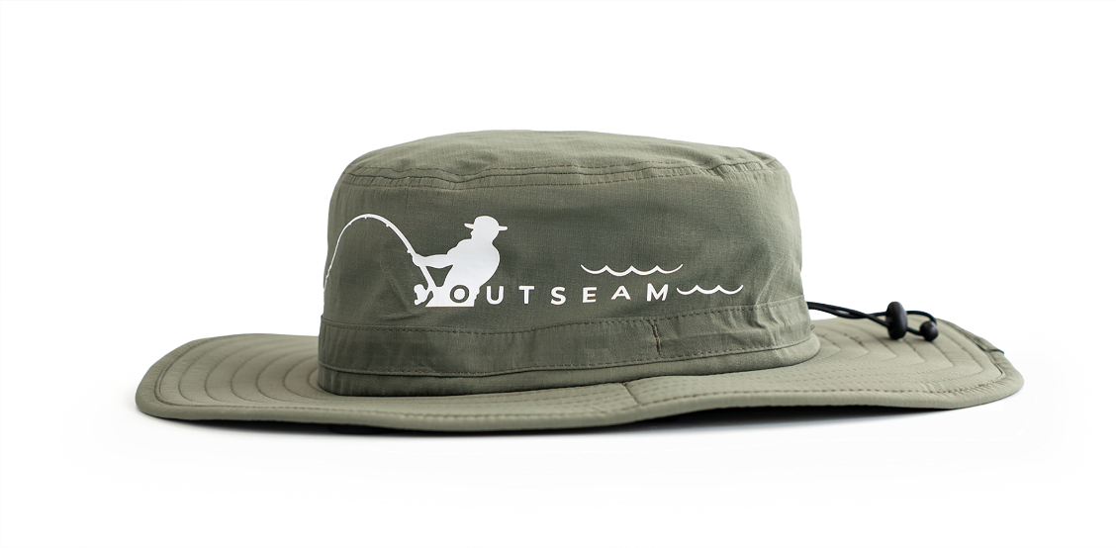
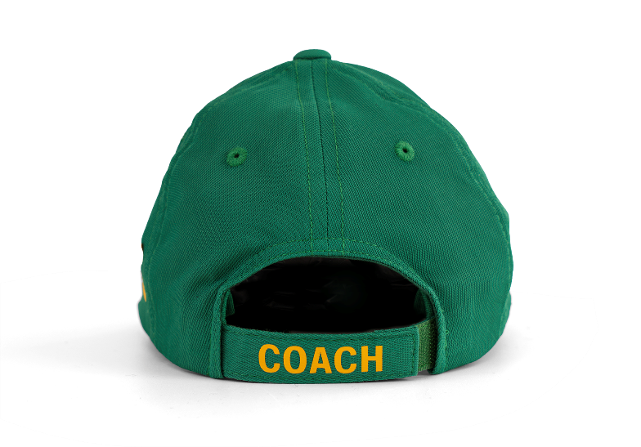
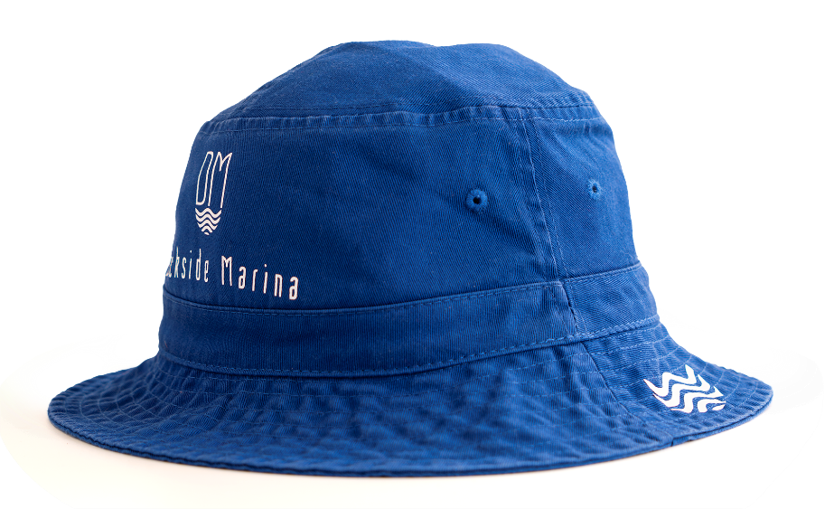
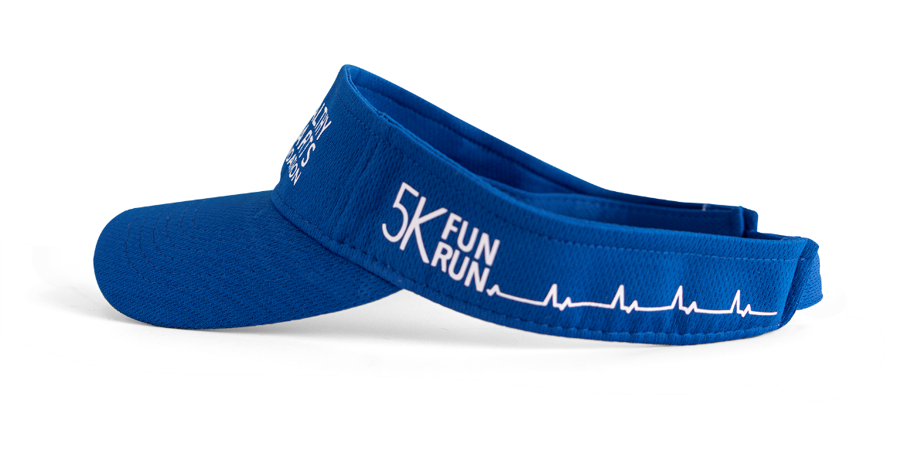
INCREASING VISIBILITY – 360 DEGREES
Any style, any placement.
Variety of hats
Endless placements

Slide 15
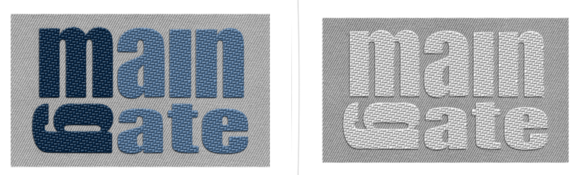
Money Saving Tips
1
2
3
4
USE COMMON SIZES
ADHESIVES
COLOR CHANGES
PRICING

Slide 16
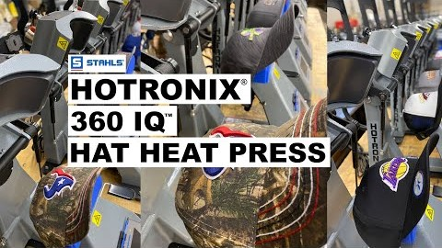
HOW TO TRAINING

Slide 17
Alison Zuccaro
Strategic Product Manager
Email me for a free sample at sdn@stahls.com

